Slide 1

Blind Faith?
Reason, Doubt, and Truth
CHRISTIAN APOLOGETICS & PHILOSOPHY

Slide 2
"
I am not a Christian because I am afraid of the dark. I am a Christian because I have followed the light of reason, and it has led me to the feet of the Creator.
"
— Peter S. Williams

Slide 3
Part 01:
The Landscape of Doubt
Tracing Scepticism through Philosophy

Slide 4




Approaching Scepticism
Search for Truth
Clear Away Error
Asking tough questions is an honourable practice. Sincere questions do not frighten God; they serve as the catalyst for discovery.
Sceptics throughout history rarely attacked the true God of Scripture. They more often exposed distorted human concepts.

Slide 5


The Value of Questions
Doorway to Faith
Welcoming Doubt
Hard questions strip away false assumptions, encourage intellectual humility, and illuminate our deep need for divine revelation.
By engaging with great sceptics of history, we build a much stronger, more resilient intellectual foundation for Christian belief.

Slide 6


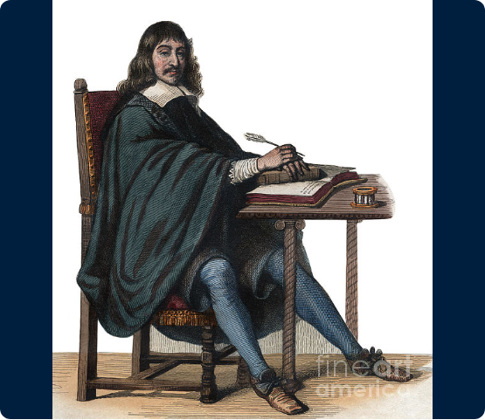
René Descartes (17th C)
Radical Doubt & Rationalism
French philosopher René Descartes sought an unshakable foundation for knowledge in an era of massive religious and scientific upheaval.

Slide 7
René Descartes (17th C)
Methodical Scepticism
He embarked on a methodical attempt to doubt everything that could possibly be doubted—including physical senses and memory.

Slide 8


Descartes: The Search for Proof
Methodological Doubt
Cogito, Ergo Sum
He arrived at the axiom: "I think, therefore I am." Even if deeply deceived, the very act of doubting proves a thinking mind exists.
Descartes systematically stripped away beliefs derived from sensory perception, recognizing that human senses can occasionally deceive.

Slide 9




Descartes: Philosophical Shifts
Mathematical Ideal
Cartesian Isolation
He shifted Western thought toward demanding 100% mathematical demonstration before accepting any truth claim as rational.
He placed the individual human mind as the ultimate judge of reality, detaching knowledge from history and community.

Slide 10
Descartes: Modern Expectations
Absolute Certainty is Rare
Living on Probability
In daily life, 100% mathematical proof is unattainable for meaningful truths, including history, personal love, and ethics.
We cannot mathematically prove friends are sincere, yet we act rationally based on high probability and deep relational trust.

Slide 11




Descartes: The Cartesian Trap
Intellectual Defense
The Trap
This fostered an unsustainable standard where any remaining, lingering doubt is treated as a total failure of belief.
Demanding absolute mathematical proof for non-mathematical reality leads directly to self-defeating paralysis.

Slide 12


Descartes: Certainty Limits
Faith is Trust
Cumulative Weight
Biblical faith (pistis) does not mean believing without evidence. It means active, rational trust based on a reliable track record.
Rather than seeking an abstract geometrical proof, theology presents a rich tapestry of historical and moral clues.

Slide 13

Descartes: Epistemic Humility
Unreasonable Criteria
Moving Beyond Doubt
Demanding absolute omniscience before committing to a belief is an unreasonable criterion for a finite human life.
Christianity answers Cartesian anxiety by recognizing that rational confidence does not require omniscient certainty.

Slide 14
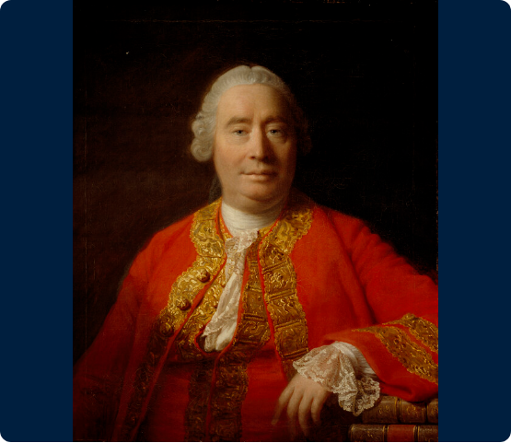
David Hume (18th C)
Empiricism & Scepticism
Scottish Enlightenment philosopher David Hume argued that all human knowledge originates strictly from physical sensory experiences.

Slide 15
David Hume (18th C)
Challenging Tradition
He boldly challenged traditional arguments for God, natural cause-and-effect, and wrestled deeply with the problem of suffering.

Slide 16


Hume: Senses & Causality
Sensory Boundary
Illusion of Causality
Hume claimed minds begin as blank slates. Because we cannot touch God directly, His existence cannot be proven empirically.
Hume argued our senses only perceive events occurring together, not necessary connection. We cannot observe God creating.

Slide 17


Hume: Beyond Physical Senses
Non-Physical Realities
Self-Defeating Empiricism
We cannot weigh, measure, or touch love, justice, human dignity, or laws of logic—yet they are profoundly real.
Hume’s claim that "only sensory experience yields truth" cannot itself be verified by sensory experience.

Slide 18




Hume: Problem of Suffering
Broken Natural World
Physicalist Restraint
He confined reality strictly to what can be measured physically, laying the groundwork for secular materialism.
Hume pointed to earthquakes and cruelty in nature, arguing that an orderly nature alone cannot prove a benevolent God.

Slide 19
Hume: Eyewitness Testimony
Critique of Miracles
Christianity is Historical
Hume argued that uniform natural laws will always outweigh human testimony regarding miraculous interventions.
Unlike abstract philosophies, Christian faith is rooted in historical sense perception—disciples saw and touched Jesus.

Slide 20


Hume: Suffering & The Cross
Acknowledging Brokenness
God Entering Suffering
Christianity agrees that creation is fractured. Scripture never claims the current world is a pristine paradise.
We discover God’s love in the Person of Jesus Christ, who entered human pain to redeem and restore creation.

Slide 21
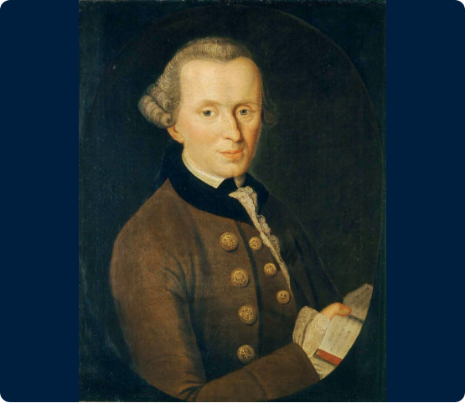
Immanuel Kant (18th C)
Limits of Human Mind
German philosopher Immanuel Kant sought to synthesize rationalism and empiricism by examining how the mind processes reality.

Slide 22

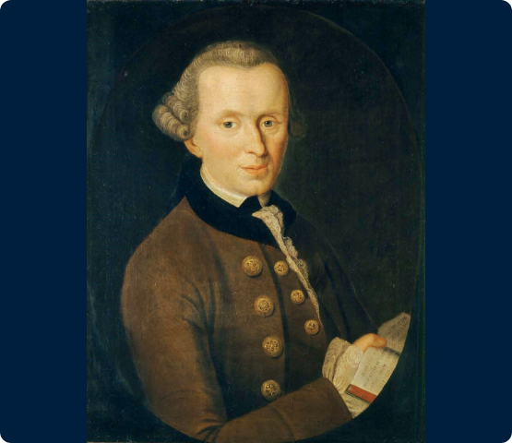

Immanuel Kant (18th C)
Filtering Reality
He argued that our brains actively filter sensory input through built-in categories like space, time, and causality.

Slide 23
Kant: Two Realms of Being
The Phenomenal Realm
The Noumenal Realm
The physical world as filtered through human senses. This is the legitimate domain of scientific study.
Ultimate reality in itself, including God, the soul, and moral duty—forever beyond scientific inspection.

Slide 24




Kant: Boundaries of Science
Scientific Tools Specific
Protection from Scientism
Kant proved that scientific methodology is designed specifically to analyze physical matter and energy, not spirit.
This protects believers from "scientism"—the false claim that physical science is the sole arbiter of all reality.

Slide 25


Kant: The Epistemic Divide
Scientific Enclosure
Agnostic Barrier
He encouraged the view that reason can only operate within the physical world, relegating spiritual truths to opinion.
He built a philosophical wall separating theoretical human intellect from transcendent, knowable spiritual truth.

Slide 26
Kant: Need for Revelation
Reason Cannot Climb
The Incarnation Solution
Because human intellect cannot cross the noumenal divide on its own, we require God to bridge the massive gap.
God reached down into the phenomenal realm through Jesus Christ—making the transcendent God visible.

Slide 27


Kant: Reaching Across Divide
Scriptural Clarity
Realms Reconciled
Special revelation provides the trustworthy bridge between finite human minds and divine reality.
Christianity confirms that finite minds cannot discover God through speculation; God stepped into time.

Slide 28
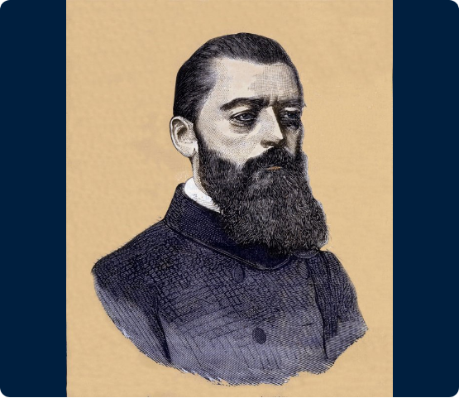
Ludwig Feuerbach (19th C)
Psychological Projection
German philosopher Ludwig Feuerbach asserted that religion is merely an invented psychological projection born of human longing.

Slide 29

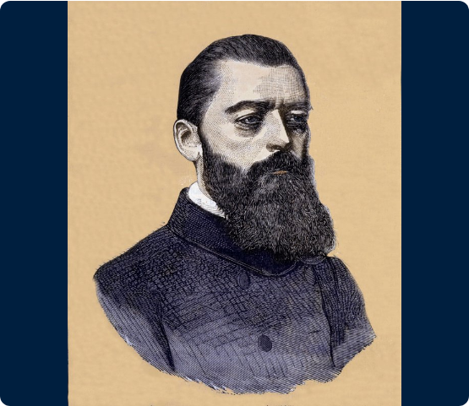
Ludwig Feuerbach (19th C)
The Heavenly Canvas
He claimed humans project their ideal virtues onto an imaginary heavenly canvas and simply call it "God."

Slide 30
Feuerbach: Wishful Thinking
God as Parental Figure
Anthropomorphic Mirror
Feuerbach argued that helpless humans invent a cosmic Parent to feel protected in an unpredictable universe.
He claimed: "God is merely human nature projected into infinity." Religion impoverishes humanity.

Slide 31

Feuerbach: Psych Scepticism
Freudian Precursor
Secular Reduction
He paved the way for Sigmund Freud's later view of religion as an illusion and a wish-fulfillment neurosis.
He encouraged modern culture to dismiss deep spiritual experiences as mere brain chemistry or an emotional crutch.

Slide 32
Feuerbach: Argument from Desire
Desire Points to Reality
Transcendental Longing
As C.S. Lewis noted, innate human desires correspond to real objects: physical hunger points to real food.
Our universal desire for eternal purpose and a heavenly Father suggests we were created for spiritual reality.

Slide 33
Feuerbach: Designed for Father
Intentional Design
Uncomfortable Truths
Christianity agrees we possess a deep need for a Heavenly Father—because He designed us for relationship.
The God of the Bible is far from a comfortable crutch; He demands moral purity, self-denial, and repentance.

Slide 34
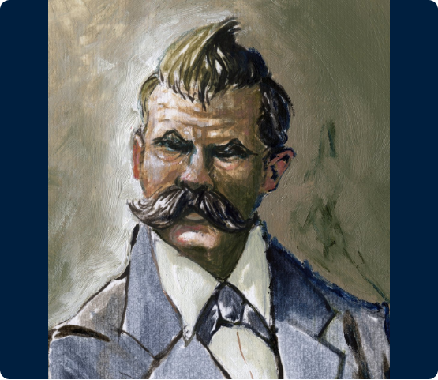
Friedrich Nietzsche (19th C)
The Collapse of Morality
German philosopher Friedrich Nietzsche prophetically recognized the radical consequences of Western secularism discarding God.

Slide 35
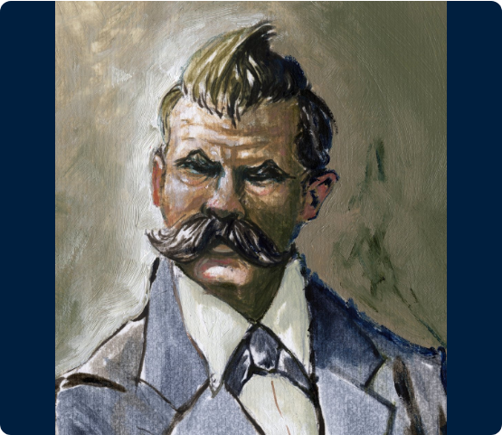
Friedrich Nietzsche (19th C)
Severing the Foundation
He warned that removing God completely destroys the essential foundation for objective moral values and human equality.

Slide 36
Nietzsche: The Death of God
Severing Moral Roots
Will to Power
Without an absolute God, objective right and wrong vanish. What remains is the strong dominating the weak.
Nietzsche observed that secular society foolishly thought it could reject God while retaining Christian ethics.

Slide 37


Nietzsche: Dismantling Myths
Detested Bigotry
Sister's Distortion
Nietzsche despised anti-Semitism and nationalist chauvinism, severing relationships over racial prejudice.
After his death, his anti-Semitic sister Elisabeth maliciously altered notebooks to fit totalitarian ideology.

Slide 38
Nietzsche: Sobering Warning
Horror of Pure Power
Exposing Inconsistency
20th-century regimes demonstrated what occurs when objective divine truth is abandoned: atrocities are justified.
He showed that without God, claims of universal human rights are groundless assumptions.

Slide 39
Nietzsche: Moral Argument
Objective Morality is Real
Requires Divine Anchor
Our conscience confirms that torturing innocents is factually evil, not merely an unhelpful social construct.
If objective moral duties actually exist, there must be a transcendent Moral Lawgiver who grounds them.

Slide 40
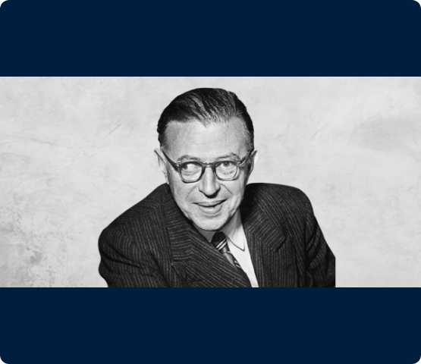

Jean-Paul Sartre (20th C)
Existentialism & Freedom
French philosopher Jean-Paul Sartre was a leading figure in 20th-century atheist existentialism.

Slide 41
Jean-Paul Sartre (20th C)
No Built-In Design
He argued that without God, humans lack any built-in design, leaving us entirely responsible for defining ourselves.

Slide 42
Sartre: Existence Precedes Essence
No Blueprint Creator
Condemned to be Free
First humans exist in an empty universe; only afterward do we construct our identity through sheer choice.
Without a Creator, humans bear the dizzying, anxious burden of inventing meaning from scratch.

Slide 43


Sartre: Existential Anxiety
Existential Loneliness
Exhausting Duty
Imposes an unbearable burden of self-creation, where failure brings deep angst and profound despair.
Leaves humanity completely abandoned in an indifferent cosmos with no ultimate hope or divine comfort.

Slide 44
Sartre: Secular Dread
Honest Diagnosis
Failure of Self-Invention
Sartre accurately described the deep isolation that results when humans attempt to act as their own god.
If we invent our own purpose, we can un-invent it, leaving us grounded in nothingness.

Slide 45
Sartre: Created Purpose
Essence Precedes Existence
Rescued from Self-Creation
The biblical view reverses Sartre: God envisioned, purposed, and loved us long before our existence.
We do not carry the crushing burden of inventing our identity; our profound purpose is lovingly given.

Slide 46
Part 02:
The Scaffold of Reason
Investigating the Evidence

Slide 47
The Detective Paradigm
Best Explanation
Rational Clues
We examine the cumulative footprints left behind in the universe to infer the best, most rational cause.
Faith evaluates physical origins, fine-tuning, and moral realities as clear clues pointing to an Intelligent Mind.

Slide 48

Clue 1: Cosmological Argument
Premise 1: Whatever begins to exist has a cause. Something cannot pop into existence out of absolute nothingness.
Premise 2: The universe began to exist. Modern astrophysics confirms space, time, and matter originated 13.8 billion years ago.

Slide 49
Clue 1: Cosmological Argument
Conclusion: Therefore, the universe has a cause—a timeless, spaceless, immaterial, extraordinarily powerful Creator.

Slide 50
Clue 2: Cosmic Fine-Tuning
Constant Precision
Razor's Edge
The universe is balanced on a razor's edge. Laws of physics exhibit mathematical precision defying chance.
If the expansion rate differed by 1 part in 10^120, the cosmos would collapse. This points to Design.

Slide 51
Clue 3: The Moral Lawgiver
Objective Reality
Beyond Nature
Right and wrong are factual. Torturing an innocent is not merely unhelpful—it is objectively evil.
Absolute moral value requires a transcendent source outside the physical world—a moral Lawgiver.

Slide 52
The Disaster of Absurdity
Undermining Reason
Self-Defeating Secularism
If atheism is true, the human brain is merely an accidental byproduct of unguided mutations.
If thoughts are just chemical fizzing, there is no logical reason to trust one's own arguments.

Slide 53
Apologetic Comparison (1/2)
Dimension | Secular Scepticism | Christian Apologetics
Certainty | Mathematical proof impossible; doubt yields paralysis. | Trust grounded in cumulative circumstantial evidence.
Cosmos Origin | Eternal universe or popped from absolute nothingness. | Called into being by a timeless, powerful Creator.

Slide 54
Apologetic Comparison (2/2)
Dimension | Secular Scepticism | Christian Apologetics
Fine-Tuning | Incredibly lucky accident or infinite multiverses. | Clear mathematical pointer to an Intelligent Mind.
Human Identity | Self-invented purpose (Sartre) or a wishful illusion. | Designed by a Heavenly Father for eternal fellowship.

Slide 55

Group Discussion (1/2)
Hume & Suffering: How does centering Jesus on the Cross change our response to suffering compared to secular models?
Kant & Science: Is it liberating or frustrating to realize science cannot measure spiritual reality?

Slide 56
Group Discussion (2/2)
Feuerbach & Desire: How does being designed for a Heavenly Father transform the "wishful thinking" critique?
Nietzsche & Morals: Can a secular society successfully maintain human rights without a divine anchor?

Slide 57


Weekly Reflection Practice
Engage Scepticism
Nocturnal Examen
Spend 15 minutes reading an articulate sceptic or Christian philosopher with an open mind.
Step outside at night, look at the cosmos, and contemplate the massive precision of our universe.

Slide 58






Image Sources
https://images.fineartamerica.com/images/artworkimages/medium/2/portrait-of-rene-descartes-1596-1650-french-philosopher-and-writer-french-school.jpg
Source: fineartamerica.com
https://s3-eu-west-1.amazonaws.com/ngs-mw-prod/9/65/3569/3569.jpg
Source: www.nationalgalleries.org
https://upload.wikimedia.org/wikipedia/commons/7/79/Immanuel_Kant_-_Gemaelde_1.jpg
Source: en.wikipedia.org
https://www.meisterdrucke.fr/kunstwerke/800px/Unknown_artist_-_Portrait_of_Ludwig_Feuerbach_(1804-1872)_German_philosopher_-_(MeisterDrucke-1023797).jpg
Source: www.meisterdrucke.fr
https://www.meisterdrucke.ie/kunstwerke/1260px/Alessandro_Lonati_-_Portrait_of_the_German_philosopher_Friedrich_Nietzsche_%281844-1900%29_-_%28MeisterDrucke-1458948%29.jpg
Source: www.meisterdrucke.ie
https://ethics.org.au/wp-content/uploads/2022/02/Big-Thinkers-header-1-1.png
Source: ethics.org.au

