Slide 1
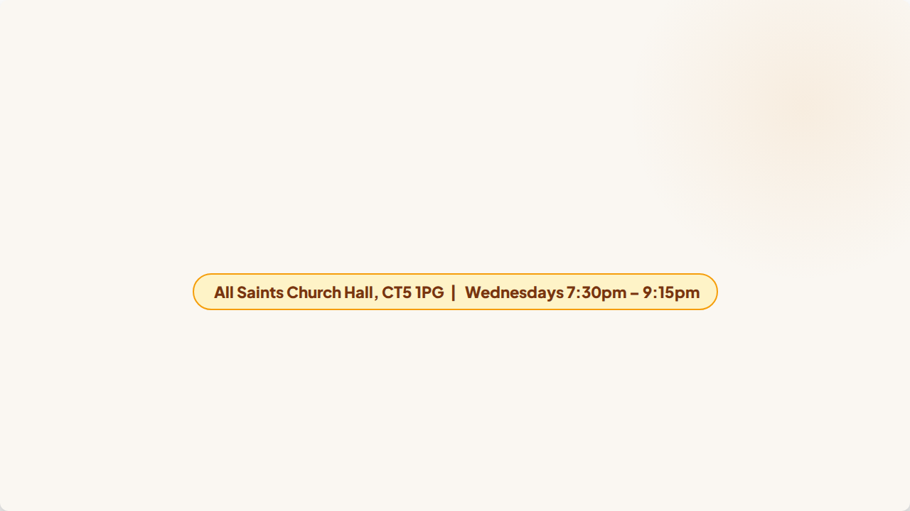
EXPLORING FAITH
A 5-Week Formation Journey for Seekers, Sceptics & Believers
Starting Wednesday 29th July 2026 • Course devised & written by Revd Simon Tillotson

Slide 2

Course Syllabus & Overview
Date | Week | Theme | Optional Readings
29 July 2026 | Week 1 | Faith Reborn: Deconstructing Caricatures & Coming Home | God of Surprises (Hughes) Return of the Prodigal Son (Nouwen)
5 Aug 2026 | Week 2 | Blind Faith? Reason, Doubt, & Intellectual Integrity | Story of Philosophy (Magee) Case for God (Williams)
12 Aug 2026 | Week 3 | Faith in Whom or What? The Cosmic & Universal Christ | Following Celtic Way (Bradley) Universal Christ (Rohr)
19 Aug 2026 | Week 4 | Stepping Out in Faith: Cost & Radical Risk of Discipleship | Discipleship (Watson) Discipleship (Arnold)
26 Aug 2026 | Week 5 | Growing in Faith: Furnace of Suffering & Problem of Evil | The Thorn (Kendall) The Shack (Young)
Venue: All Saints Church Hall, CT5 1PG | Time: Wednesdays, 7:30pm – 9:15pm

Slide 3


Week 1: Faith Reborn
Hitting the 'Factory Reset' Button
Tonight's Two Core Pillars
Designed to help us unburden ourselves from toxic spiritual baggage and caricatures.
Exploring insights from two complementary spiritual classics:
•
Welcomes sceptics, seekers, and long-time believers alike
•
Gerard W. Hughes (God of Surprises): Overcoming false caricatures & dismantling the 'Inner Police State'
•
Childhood Sunday school theology fails in adult grief & complexity
•
Henri Nouwen (Return of the Prodigal Son): Finding our way home through Rembrandt's map of the Father's embrace
•
Requires us to permanently dismantle and let go of false caricatures
•
Reconstructs intellectual integrity & ancient insights

Slide 4
Part 1: The Gods We Must Reject
“
— Gerard W. Hughes, God of Surprises
"The 'God' whom many people reject is a caricature of God, a monster of our own making, who deserves to be rejected."
— Gerard W. Hughes, God of Surprises
We often build our images of God out of early childhood fears, parental authority figures, and rigid institutional conditioning.

Slide 5



Dismantling False Gods (Part 1)
1. The Celestial Policeman
2. The Meticulous Examiner
Profile: Hidden behind a heavenly speed camera in life's bushes, waiting to flash lights and issue cosmic fines.
Profile: Detached academic headteacher checking theological spelling, liturgical formulas, and doctrinal purity.
Impact: Spirituality defined by anxiety, hyper-vigilance, and chronic guilt. Life treated as a minefield rather than an adventure.
Impact: Legalistic faith that terrifies honest doubters and turns believers into self-righteous, fearful perfectionists.

Slide 6
Dismantling False Gods (Part 2)
3. Grandfather in the Attic
4. Cosmic Insurance Agent
Profile: Kindly historical relic tucked away in history. Nice at Christmas or harvest, but without modern power.
Profile: Transactional God. Pay premiums via good deeds and attendance to guarantee protection from tragedy.
Impact: Functional atheism Monday to Saturday, completely separating spiritual life from daily choices and careers.
Impact: Shatters when illness or bereavement strikes ("Why me? I paid my dues!"), turning faith into a broken contract.

Slide 7
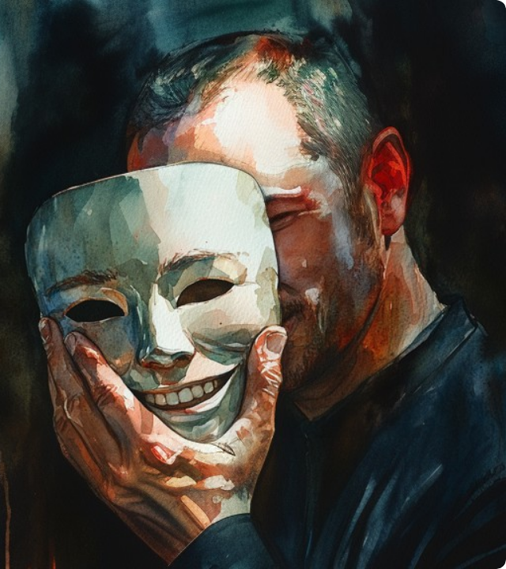
The Inner Police State
The Divided Self
Serving false caricatures forces us into an inner police state that splits us into two distinct people:
• The Religious Mask: The "good Christian" persona hiding doubts, anger, and messy desires.
• The Real Self: The hidden person beneath experiencing doubts, confusion, and despair.
"God cannot transform the person we are pretending to be; He can only meet us in our absolute reality."
— Gerard W. Hughes

Slide 8

The God of Surprises
Meeting Reality
Rejecting false caricatures clears toxic weeds so genuine faith takes root in our lives.
• Found in Weakness: Revealed in failures and clay-jar humanity, not perfection.
• Found in Honesty: Prefers an angry cry of protest over hollow, polished piety.
• Found in Desires: Authentic longings draw us back home to Him.
"Faith is the open-ended willingness to let God be who He is."

Slide 9


Group Discussion: Part 1 (Hughes)
Question 1: False Caricatures in Daily Life
Which of the four false caricatures of God (Policeman, Examiner, Grandfather, Insurance Agent) do you catch yourself slipping back into most easily when life becomes difficult, stressful, or chaotic?
Question 2: The Mask & The Real Self
Looking at the split between the 'Religious Mask' and the 'Real Self', why do you think we find it so threatening to reveal our raw, unfiltered doubts, anger, and feelings within religious communities?

Slide 10
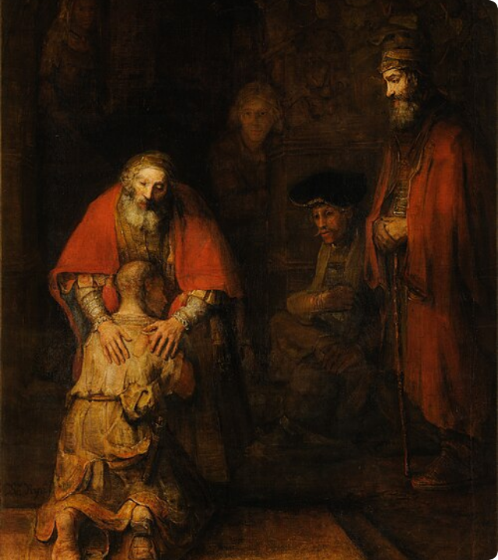
Part 2: Homecoming
Henri Nouwen's Roadmap
Based on Rembrandt's masterpiece painting of Jesus' parable in Luke 15.
A profound spiritual map outlining three core postures of the human condition:
• 1. Younger Son: The Exhausted Wanderer
• 2. Elder Son: The Bitter Rule-Follower
• 3. The Father: The Dual Embrace

Slide 11


1. The Younger Son
The Exhausted Wanderer
The Homing Beacon
Driven by a search for conditional love:
Returning on empty:
•
Flees home to seek validation through worldly achievement
•
Motivated not by solving intellectual puzzles, but by utter starvation and exhaustion
•
Enters the modern 'distant country': building identity apart from God ("I am only what I achieve")
•
Personal baseline crashes become the homing beacon guiding seekers back to the Father
•
Loss of identity depicted by tattered clothes and blistered feet
•
Discovers that exhausted wanderers are welcomed with open arms

Slide 12
2. The Elder Son
The Bitter Rule-Follower
Warning for Believers
Lost while inside the father's house:
The trap of churchgoers:
•
Body stayed at home, but heart wandered into cold moralism and isolation
•
Terrifyingly easy to stay inside church, keep rules, yet harbour hidden bitterness
•
Driven by a joyless 'slaving' mindset: viewing obedience as a transaction
•
If faith feels like a resentful obligation, you are standing outside the party with the elder son
•
Furious at unearned grace; trapped in legalistic karma mindset
•
The Father steps out into the dark to plead with the elder son too

Slide 13

3. The Dual Embrace
The Mismatched Hands
Rembrandt depicts the Father's hands as distinctly different:
• Left Hand (Masculine): Broad, strong, protective. "You are safe now; I will secure your future."
• Right Hand (Feminine): Gentle, caressing. Offers a mother's tender refuge.
The Ultimate Calling: Growing up spiritually to become the Father's hands for a broken world.

Slide 14


Group Discussion: Part 2 (Nouwen)
Question 1: Personal Baseline Crashes
Nouwen suggests that personal exhaustion often becomes the 'homing beacon' guiding seekers back to faith. Have you ever experienced a baseline crash that forced a reset of your spiritual path?
Question 2: The Elder Son Mindset Today
In what ways do you see the 'Elder Son' mindset showing up as cold moralism, relational distancing, or quiet resentment inside institutional church circles today?
Question 3: Practical Dual Embrace
What does it look like practically to offer a 'dual embrace' (protective strength and tender care) to someone in your immediate local community?

Slide 15
Part 3: Re-Coding the Divine
Paradigm | False Caricatures (Dismantled) | Relational Reality (Recovered)
Foundational Stance | Surveillance, grading, scoring, legal enforcement. | Hospitality, running welcome, protective strength, tender care.
Human Status | Cosmic defendant, stressed examinee, contract holder. | Exhausted child, bitter worker, raw human self, future parent.
Core Motivation | Fear of fines, failure, legacy relevance, or loss of coverage. | Honesty in the basement, dropping masks, responding to deep desires.

Slide 16
Part 4: Diagnostic Prompts
1. Caricature Identification: Which false profile (Policeman, Examiner, Grandfather, Insurance Agent) did your upbringing paint most vividly? How does it show up in stress?
2. Locating the Mask: What specific doubts, feelings, or questions are you locking in your inner basement because you assume they are 'unchristian'? What would it look like to bring them to light?
3. The Sibling Audit: Strip away external presentation—which fatigue is consuming you? Exhaustion of striving in a distant country, or quiet bitterness of joyless duty at home?

Slide 17
Part 5: Two-Minute Examen
1. Find Absolute Silence: Spend two minutes in quiet every day (while kettle boils or before sleep).
2. Drop the Mask: Step completely out of your religious persona—no archaic words or pretense.
3. Name Your Reality: Speak your exact state to the dark (exhaustion, doubt, anger, or fatigue).
4. Visualise the Embrace: Feel the mismatched hands of the Father resting on your shoulders.
5. Extend the Invitation: "God of surprises, if you are truly there, step past my religious baggage this week. Surprise me."

Slide 18
Questions & Fellowship
Thank you for joining us for Week 1
Next Week (5 Aug): Week 2 — Blind Faith? Reason, Doubt, & Intellectual Integrity

Slide 19




Image Sources
https://www.hiddenbrain.org/wp-content/uploads/2025/02/Kenji-Mask-for-web.jpg
Source: www.hiddenbrain.org
https://images.unsplash.com/photo-1751268575395-a2448a26d9d1?fm=jpg&q=60&w=3000&auto=format&fit=crop&ixlib=rb-4.1.0&ixid=M3wxMjA3fDB8MHxwaG90by1wYWdlfHx8fGVufDB8fHx8fA%3D%3D
Source: unsplash.com
https://upload.wikimedia.org/wikipedia/commons/thumb/9/93/Rembrandt_Harmensz_van_Rijn_-_Return_of_the_Prodigal_Son_-_Google_Art_Project.jpg/500px-Rembrandt_Harmensz_van_Rijn_-_Return_of_the_Prodigal_Son_-_Google_Art_Project.jpg
Source: en.wikipedia.org
https://static.vecteezy.com/system/resources/previews/068/184/585/non_2x/heartwarming-scene-of-a-father-embracing-his-young-son-symbolizing-love-family-bond-and-paternal-care-in-a-joyful-and-cherished-moment-png.png
Source: www.vecteezy.com

